Slide 1
WHY UZBEKISTAN?

Slide 2
WHY UZBEKISTAN?
Strong economic fundamentals
Competitive costs
6,5
%
Average GDP annual growth
Least expensive’ according to The Economist Cost-of-living Index (2024)
20
%
Export growth in 2024
$45
High FX reserves
bln
36
%
Low gov’t debt

Slide 3
WHY UZBEKISTAN?
Large growing market – 37M+
Free trade agreements
20
Economically active & 88% under 55
300
Access to consumer markets
Mln people
Mln people
+1
Population growth
6K
EU’s GSP+ agreement for goods
Mln
goods
50
%
Growing Middle Eastern markets
Urban population

Slide 4
WHY UZBEKISTAN?
Significant natural resources
Green infrastructure
10
In gold production
54
Renewables target by 2030
%
Top
10
In copper reserve
$14
Investment to date
Top
15
Bln
In uranium production
Leading green hydrogen initiative in the region
Top

Slide 5
INSTITUTIONAL REFORMS
Tax Reform
Foreign Investors Council under the President
E-gov services increased
from 96 to 400
Foreign exchange market liberalization
Law on “Investments and Investment Activities”
Law on PPP
Trade deregulations
500 functions of the Government on regulation of business were removed
Countries with visa-free regime increased from 9 to 90+

Slide 6
ACHIEVEMENTS
$34.9B
$22.4B
$120B
Foreign investment
$3.4B
(2018-2024)
2023
2017
2024
FDI INFLOWS

Slide 7
WTO ACCESSION AS THE MAIN REFORM AGENDA
Accession Process
Decree UP-85 (June 3, 2024)
Economic Impact
8 Working Party meetings and 17 bilateral negotiations completed
Focuses on market reforms for WTO alignment
Regional Integration: Value chains and trade hubs through FTA and improved trade facilitation
Ends state monopolies in gas, electricity, and metals
Agricultural negotiations initiated in 2024
Expansion of Services: Financial, telecom, transport open to foreign investors
Deregulation for gas, electricity, and metals sectors
Accession is expected by 2026
Transparency for public procurement
Sustainability: Water management and trade policies for regional cooperation
Phasing out export subsidies conflicting with WTO
Full implementation by 2026

Slide 8
UZBEKISTAN IS AT THE HEART OF GROWING CONSUMER MARKETS
Local market
Regional market
Middle Eastern markets
2050
46 mln
%
2050
106 mln
%
2050
76 mln
%
28
31
27
2024
36 mln
2024
82 mln
2024
61 mln
Half of the population of Central Asia live in Uzbekistan.
Direct access the Central Asian markets: Kazakhstan, Kyrgzstan, Tajikistan, and Turkmenistan
500m population in high-income markets of Europe and the Gulf Cooperation Council (UAE, Saudi Arabia, Qatar, Bahrain, Oman and Kuwait)
increased earnings and increasing demand for processed and pre-prepared food
Long established trading routes are supported by integrated road and rail networks
High income markets
440
60
Vast labour market in the agrifood industry.
Market is expected to grow from 80m to 100m people over the next 25 years
Mln people
Mln people
EU
GCC

Slide 9
THE KEY CITIES OF UZBEKISTAN SIT ON THE STRATEGIC INTERNATIONAL LOGISTICS CORRIDOR
Tallin
Sankt-Peterburg
Riga
Latvia
Moscow
Klaipeda
Hamburg
Minsk
Berlin
Brest
Povorina
Essen
Lviv
Kyiv
Paris
Chop
Volgograd
Kandiagash
Aktogay
Astraxan
Beyney
Saksaulskaya
Ulan-Bator
Osh
Bayangal-Mangal
Mersin
Malatya
Saraxa
Mazar-i-Sharif
Kashgar
Xirat
Afghanistan
Peshavar
Iran
Pakistan
Bandar-e-Abbas
Chakhbahar
Karachi

Slide 10
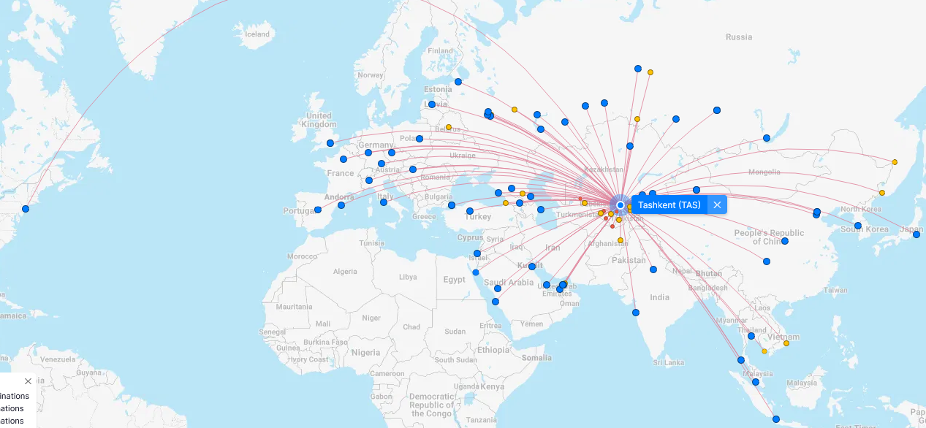
EXCELLENT AIR CONNECTIVITY FROM TASHKENT AND OTHER UZBEK AIRPORTS
A visa-free policy for tourists from 90 countries
Diverse range of 59 carriers in Uzbekistan’s airport
11 airports across the Country
Direct flights to NYC and Tokyo in the region
Direct cargo flights from Xi’an, largest cargo terminal in China
Samarkand Airport as the 2nd fastest growing in Europe & Central Asia combined in 2024

Slide 11
GOVERNMENT INCENTIVES: FREE ECONOMIC ZONES
1
Karakalpakstan
6
Surkhandarya
FEZ Nukus – 152,5 ha SIZ Nukus Technopark – 30,0 ha SIZ Karaozak
FEZ FEZ Termez – 64,5 ha
1
Jizzakh
5
7
FEZ Angren – 791.9 ha FEZ Parkent-pharm – 17.3 ha FEZ Nustanlyk-pharm – 37.0 ha
2
2
9
Khorezm
10
12
FEZ Khazarasp – 242,4 ha
7
13
11
3
8
Samarkand
8
3
Bukhara
FEZ Urgut – 1 091.1ha
4
FEZ Gijdivan – 664,4 ha FEZ Bukhara Agro – 2362,7 ha FEZ Karakul – 499,1 ha
Fergana
6
11
Tashkent
FEZ Kokand – 358.7 ha
9
FEZ Angren – 791.9 ha FEZ Parkent-pharm – 17.3 ha FEZ Nustanlyk – 37.0 ha
4
Kashkadarya
Andijan
FEZ Chirakchi– 72,0 ha
12
SIZ Special Industrial Hub for Mechanical Engineering and Electrical Engineering – 74.8 ha FEZ Andijan-pharm – 44.5 ha FEZ Ipak yuli – 218.2 ha
13
Syrdarya
FEZ Syrdarya – 375.5 ha
FEZ Syrdarya-pharm– 54.0 ha
5
Navoi
10
Namangan
FEZ Navoi – 711,5 ha
FEZ Namangan – 373.0 ha FEZ Kosonsoy-pharm – 81.0 ha

Slide 12
FAST FACTS – TEXTILE INDUSTRY SNAPSHOT
2.9
Total exports from Uzbekistan in 2024
+$100M
+$50M
bln
10
%
Y-o-Y production increase to $8,3 bln in 2024
10 textile companies with annual exports
45+ textile companies with annual exports
$3
Invested in the last 5 years into the sector development
134
700K
Cotton Clusters
bln
5 Cotton fields: 1.03 m.Ha Harvest: 3.5 m tons
people employed
Success stories in Uzbek textile market

Slide 13
FAST FACTS – CHEMICAL INDUSTRY SNAPSHOT
3.0
Total exports from Uzbekistan in 2024
20
bln
Uzkimyosanoat
%
subsidiaries
139
Y-o-Y production increase to $2,1 bln in 2024
the largest chemical producer in Central Asia Region
13 industrial enterprises across Uzbekistan
75
+35K
44
Investment projects worth US$10,6 bln in pipeline
%
Of the chemical sector output in 2023 are mineral fertilizers
people employed
Success stories in chemical sector of Uzbekistan

Slide 14
FAST FACTS – 2024 AGRIFOOD PRODUCTION SNAPSHOT
25
%
GDP
12.0
9.0
16.0
4.0
26
%
National employment
mln.t
mln.t
mln.t
mln.t
milk
cereal
vegetables
potatoes
%
4,0
5.0
3.0
2.0
10.0
Growth annually
2.8
mln.t
mln.t
mln.t
bln
Meat
fruits & berries
melons
grapes
eggs
mln. t
Success stories in agrifood sector of Uzbekistan

Slide 15
Public-Private Partnership (PPP)
63
$30,3
Projects
bln
Projects
Transport
14
Projects
Energy
18
Projects
Social
14
Projects
Communal
9
Projects
Ecology
4
Projects
Water resources
2

Slide 16
ENERGY
$14 bln
44 GW
Construction and operation of 965 MW Tutly solar power plant
Over $3bln investment in energy and infrastructure
Investment in clean energy to date
Planned renewable energy projects by 2030
54 %
2050
1,600 MW CCGT power plants in Syrdarya region.
PPA and EPC for 1,600 MW Syrdarya II CCGT project
Share of renewable energy in grid by 2030
Target set for the carbon neutrality
Solar, wind, battery energy storage projects exceeding 4 billion USD across the country
Renewables and hydrogen projects of 7.5 billion USD across the country
Hybrid, solar and wind projects in Khorezm and Bukhara
Investments in conventional power production

Slide 17
PIPELINE OF PROJECTS
Manufacturing
Infrastructure
Chemicals
Construction
Electric vehicle batteries
Ceramic products
Modernization of Urgench airport
Alky benzene
Generators
Float glass
Polyoxymethylene
Transformers
Hydro power projects
Wallpaper
Polymer products
Heavy machinery
Paint products
Motorway construction
Acetic Acid
Boilers
Furniture fabrics
Water saving equipment
Sewage schemes
Citric Acid
Copper foil

Slide 18
DISCOVER THE UNTAPPED POTENTIAL OF UZBEKISTAN

