Slide 1

Pripravljenost na Zakon EU o umetni inteligenci:
Kaj to pomeni za vaše podjetje
Krepitev zaupanja strank s skladnostjo pri umetni inteligenci
13. november 2025
https://www.eucompliai.com/contact
Notes:
Thanks for joining. Today I’ll show how CompliAI by SHG turns the EU AI Act into a clear, guided path - from an initial risk check to practical next steps. In the live demo, we’ll focus on the questionnaire and the risk report. I’ll also preview, on slides, how the rest of the flow looks inside the product. For deeper steps like repo integrations and monitoring, we’d need to connect to a real system and we can schedule that for another time.

Slide 2
Webinar: Dnevni red
Evropska unija – Zakon o umetni inteligenci
Ali mora vaše podjetje zagotoviti skladnost?
Naš pristop k skladnosti z Zakonom EU o umetni inteligenci, ki ga podpira CompliAI
Začetni svetovalni okvir – organizacijam omogoča razvoj upravljanja sprememb
Pregled poenostavljene skladnosti s CompliAI
Vprašanja
https://www.eucompliai.com/contact
Notes:
Compliance isn’t just about avoiding penalties; it’s about credibility. CompliAI by SHG streamlines governance and evidence so you can launch faster, cut costs, and stay compliant. Starting now creates repeatable capability—templates, evidence, and workflows you can reuse and scale across future AI systems.

Slide 3

EU AI - Razumevanje zakona
Kaj to pomeni za poslovanje v Evropski uniji
https://www.eucompliai.com/contact

Slide 4



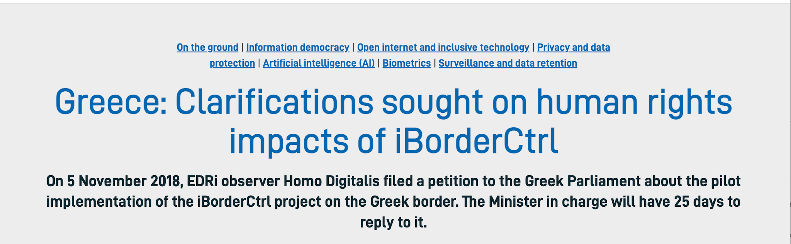
Evropska unija – Zakon o umetni inteligenci – zakaj?
Zakaj je bil ta zakon sprejet v Evropski uniji?
Vzpostavitev enotnega pravnega okvira za umetno inteligenco v EU
Zagotavlja, da je umetna inteligenca osredotočena na človeka, zaupanja vredna in temelji na spoštovanju pravic
Spodbuja inovacije ob hkratnem varovanju zdravja, varnosti in zaupanja strank
Preprečuje škodljive, manipulativne ali diskriminatorne prakse na področju umetne inteligence
https://www.eucompliai.com/contact
Notes:
This is one of the key AI Use Cases that cause the European Union to create the Artificial Intelligence Act.
Funded by the European Commission since 2016, the iBorderCtrl project involves the use of an AI-powered “lie detector”. Its aim is to automate the security process at the EU’s external borders by replacing border guards with artificial intelligence.
What happened
iBorderCtrl was a project funded by the European Commission and deployed in trials at border crossings in Greece, Hungary and Latvia in 2021.
The system used facial-movement tracking and other biometric cues (for example micro-expressions) purportedly to assess whether a person was lying when answering questions at the border.
Soon after deployment, serious concerns were raised: the company itself admitted the technology “may imply risks for fundamental human rights.”
Ultimately the project was dissolved. The technology proved unreliable, and critics flagged it as an inappropriate use of AI for high-stakes decisions.
Why it went wrong?
High-stakes context: Deploying an AI system that assesses truthfulness/arousal at border control implicates freedom of movement, human rights, discrimination risk, and power imbalance.
Unreliable methodology: Lie detection via micro-expressions or biometric cues is widely disputed in the scientific community. Using it without robust validation is risky.
Transparency & oversight issues: Individuals subject to the system likely had limited ability to challenge or understand decisions.
Regulatory & ethical gaps: This use case clearly triggers what the forthcoming EU AI Act would consider a “high-risk” or even “unacceptable risk” system (remote biometric identification, profiling). The trial illustrates the need for governance from the regulatory side.
Lessons and relevance under the EU AI Act:
This case underscores why the EU’s risk-based categorisation (unacceptable risk / high risk) is necessary: Some uses of AI simply should not be deployed without stringent safeguards or may be prohibited.
It shows that companies deploying AI in sensitive areas must maintain rigorous evidence, transparency, human oversight and robust documentation.
For compliance, one must recognise that:
Prior to deployment of certain AI systems, fundamental rights impact assessments are needed.
Transparency (i.e., explaining what the system does and how) and human oversight (a human in the loop) are critical.
Data governance, accuracy, robustness, fairness and security should be embedded from the design phase.
It also signals that weak governance or experimental deployments in absence of full oversight can damage reputation, lead to public backlash, and increase regulatory scrutiny.

Slide 5
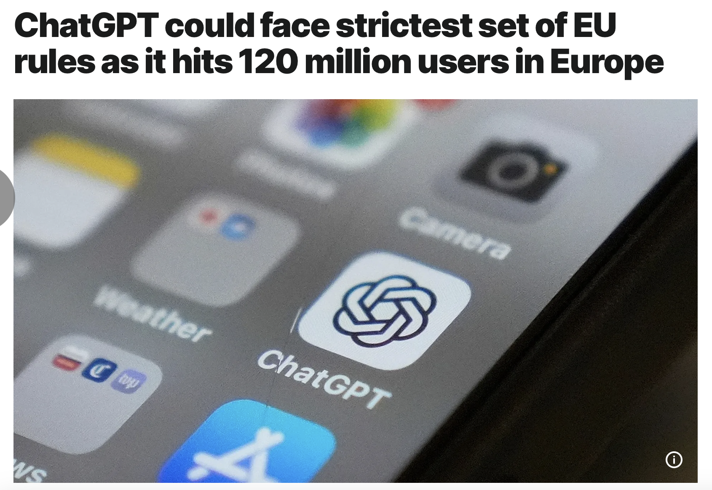
https://www.eucompliai.com/contact
Notes:
add this to the notes: ChatGPT, the AI chatbot made by US company OpenAI, could be subject to the strictest EU platform rules after it said on Tuesday that it now has more than 120 million users per month in Europe, a spokesperson for the European Commission hinted at on Wednesday.
Under the EU's Digital Services Act (DSA), which aims to combat the spread of illegal content and products online, the largest online platforms face stricter rules than smaller ones due to their significant societal impact, including their potential to spread harmful content and disinformation.
Platforms with more than 45 million users per month, such as Amazon, X, TikTok, and Meta's Facebook and Instagram, need to meet more transparency reporting obligations and pay higher supervisory fees than others to allow the Commission to keep a closer eye on the measures they take to clamp down on illegal content.
Platforms need to update the EU executive on the user numbers in the 27-member bloc every half year.
1:18
Asked at a press briefing in Brussels on Wednesday, the Commission spokesperson said the EU executive was aware of ChatGPT’s new numbers and that an assessment has begun.
“It could potentially be in the scope of the DSA, [an analysis] this has to be done on a case by case basis,” the spokesperson added.

Slide 6
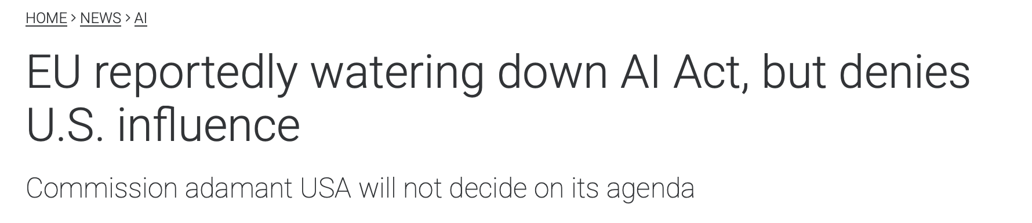
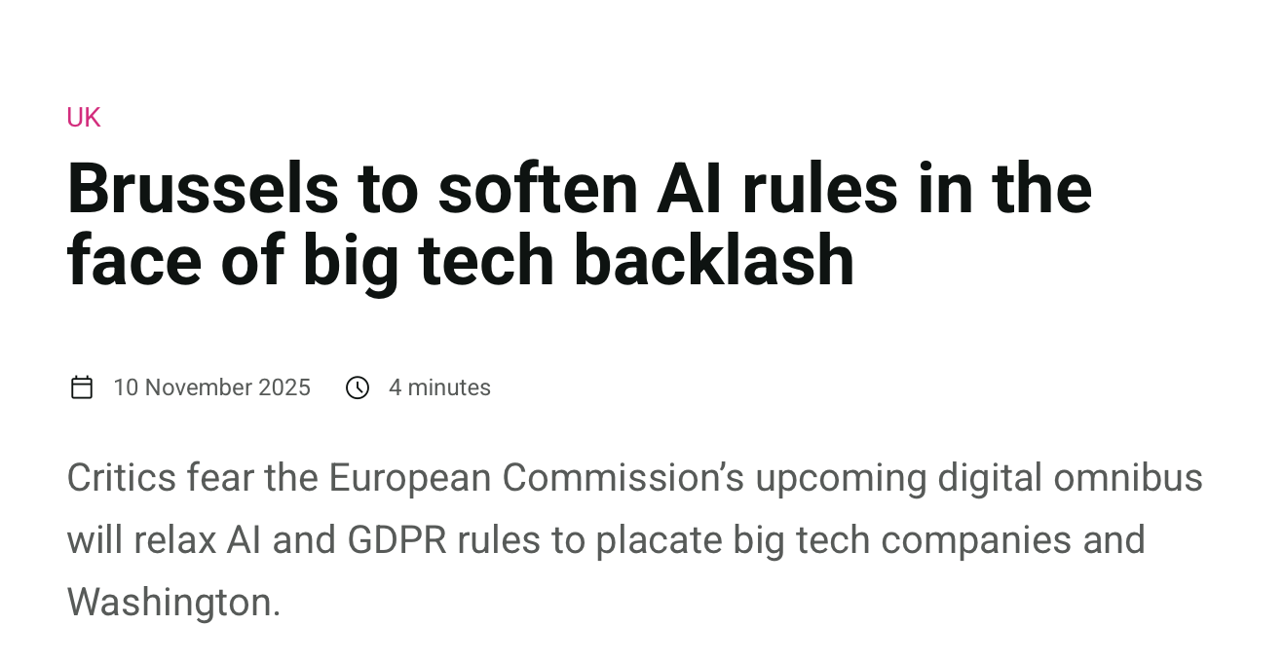


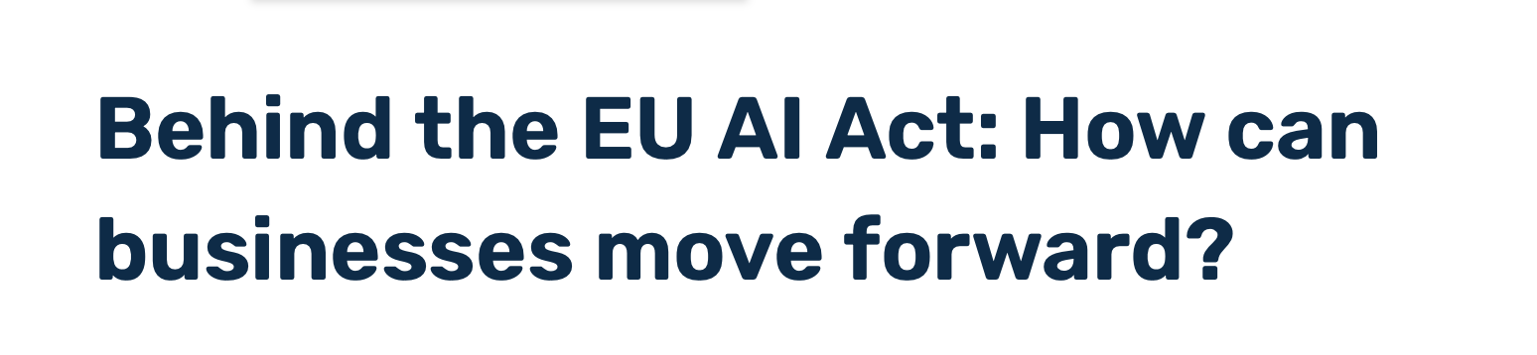
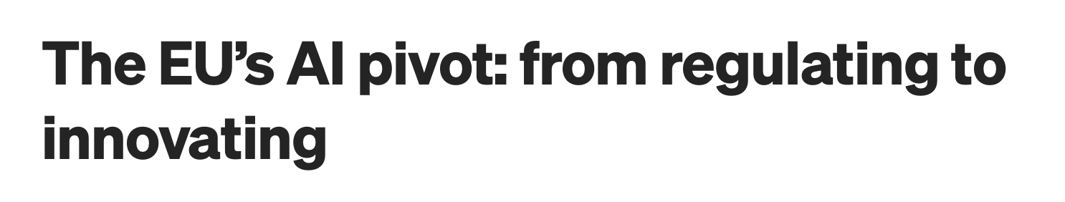
Zakon EU o umetni inteligenci – stalna zmeda
https://www.eucompliai.com/contact

Slide 7
EU AI - Kaj vemo
Temeljno upravljanje umetne inteligence
https://www.eucompliai.com/contact

Slide 8
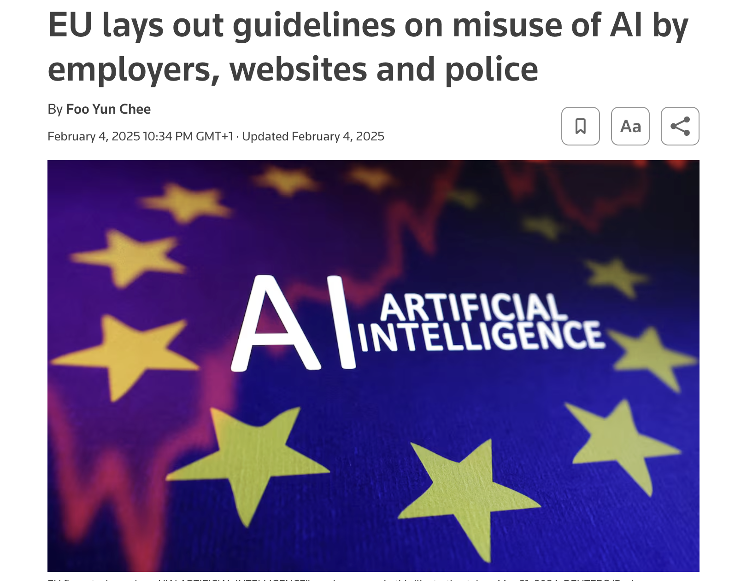
Evropska unija – regulativne osnove
Akt razvršča sisteme umetne inteligence glede na stopnjo tveganja in glede na morebiten učinek določa različne obveznosti:
1. Nesprejemljivo tveganje (prepovedano) – prepovedani so sistemi umetne inteligence, ki manipulirajo z vedenjem ljudi, izkoriščajo ranljivosti, izvajajo socialno točkovanje ali kršijo temeljne pravice (npr. subliminalno sporočanje, sistemi množičnega nadzornega točkovanja)
2. Visoko tveganje – umetna inteligenca, uporabljena v varnostno kritičnih aplikacijah (zdravstvo, izobraževanje, kazenski pregon, zaposlovanje itd.), mora izpolnjevati stroge zahteve glede obvladovanja tveganj, upravljanja, dokumentacije in preglednosti
3. Omejeno tveganje – sistemi, kot so klepetalni roboti, morajo uporabnike obvestiti, da gre za umetno inteligenco.
4. Minimalno ali brez tveganja – sistemi, kot so filtri neželene pošte ali umetna inteligenca v video igrah, nimajo posebnih obveznosti.
Akt spodbuja ravnovesje med inovacijami in odgovornostjo, kar omogoča uvajanje umetne inteligence ob ohranjanju etičnih, socialnih in kibernetsko-varnostnih zaščitnih ukrepov.
https://www.eucompliai.com/contact
Notes:
Regulatory Functions: Foundational Categorization of AI and its Use within the EU.
Imagine in a world of Remote Working that was a gift from COVID19: How creative AI use cases can / would be deployed to keep an eye on your team.
Employers cannot use webcams and voice recognition systems to track employees' emotions, while mobile CCTV cameras equipped with AI-based facial recognition technologies for law enforcement purposes are prohibited, with limited exceptions and stringent safeguards.
COMPLICATED > EU AI Act.. Pages and Pages of compliance and regulatory >>> CompliAI
The guidelines from the European Commission come as companies grapple with the complexity and cost of complying with the world's first legislation on the use of the technology.
The Artificial Intelligence Act, binding since last year, will be fully applicable on Aug. 2, 2026, with certain provisions kicking in earlier, such as the ban on certain practices from Feb. 2 this year.
"The ambition is to provide legal certainty for those who provide or deploy the artificial intelligence systems on the European market, also for the market surveillance authorities. The guidelines are not legally binding," a Commission official told reporters.
Prohibited practices include AI-enabled dark patterns embedded in services designed to manipulate users into making substantial financial commitments, and AI-enabled applications which exploit users based on their age, disability or socio-economic situation.
AI-enabled social scoring using unrelated personal data such as origin and race by social welfare agencies and other public and private bodies is banned, while police are not allowed to predict individuals' criminal behaviour solely based on their biometric data if this has not been verified.
EU countries have until Aug. 2 to designate market surveillance authorities to enforce the AI rules. AI breaches can cost companies fines ranging from 1.5% to 7% of their total global revenue.
The EU AI Act is more comprehensive than the United States' light-touch voluntary compliance approach while China's approach aims to maintain social stability and state control.

Slide 9

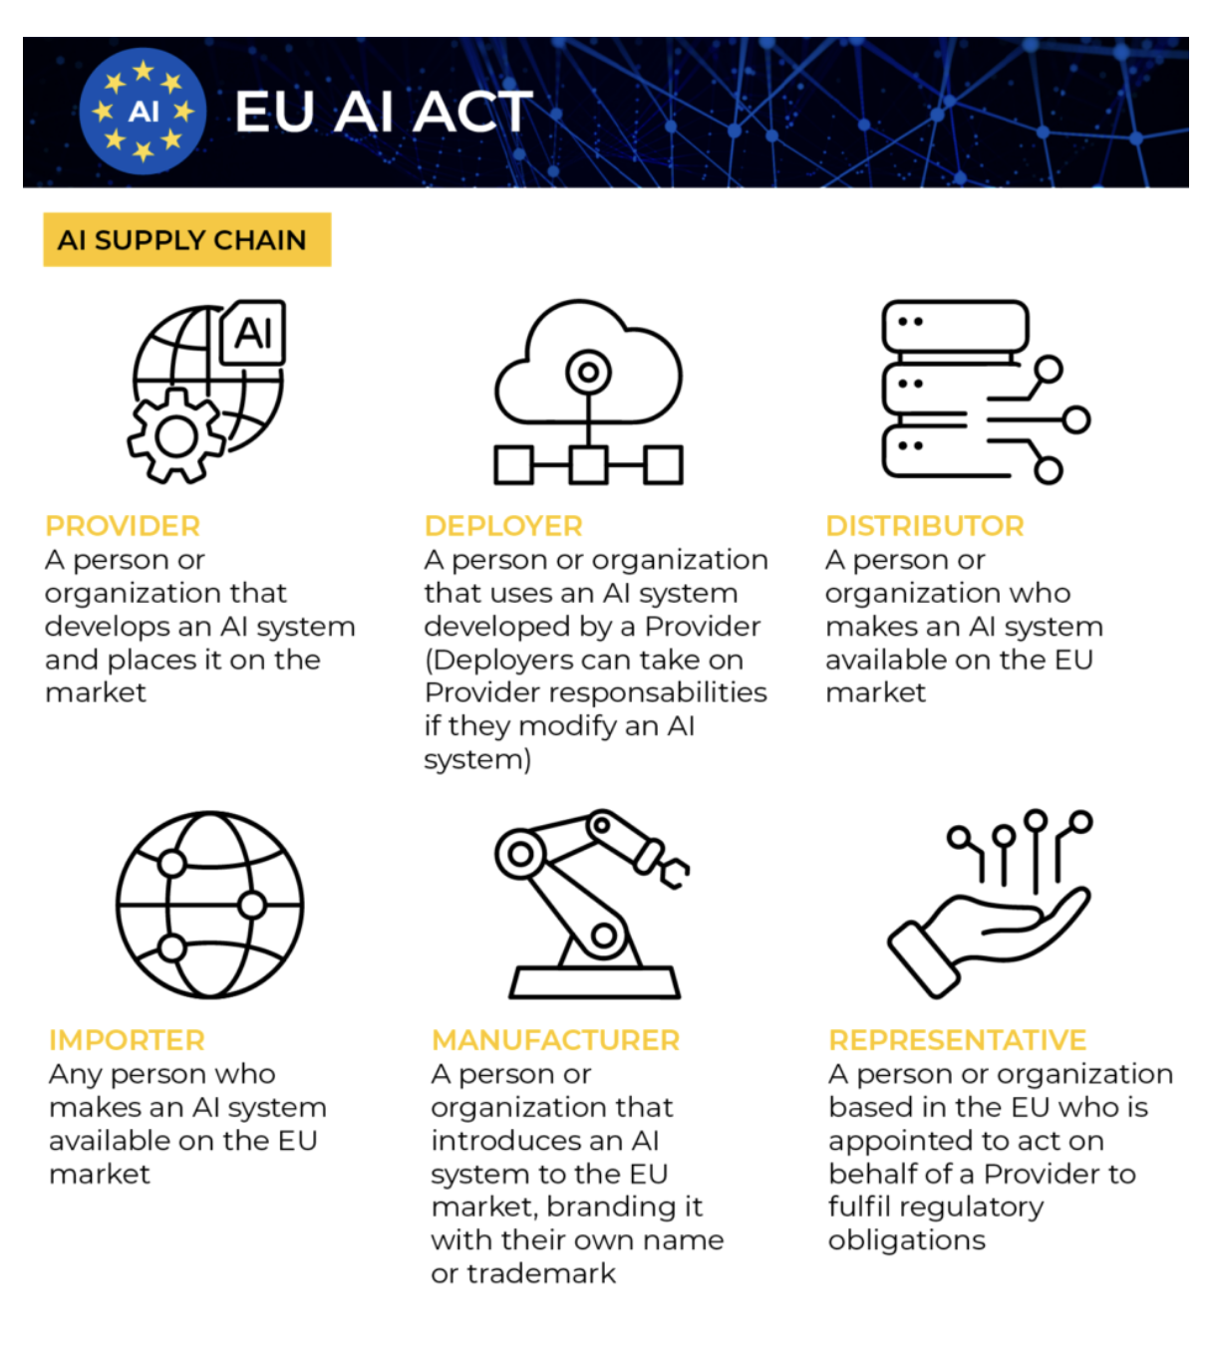

Verižna vrednost umetne inteligence – v okviru Zakona EU o umetni inteligenci
Ponudnik z visokim tveganjem
https://www.eucompliai.com/contact
Notes:
The Value Chain of Where your Company Falls within the act.
You become a Provider if you:
Retrain, fine-tune, or materially modify a foundation or pre-built AI model (e.g., GPT, Gemini, Claude) for your own clients.
Change the system’s intended purpose or functionality (e.g., turning a general chatbot into a clinical triage assistant).
Re-brand and market the AI solution under your company name.
Integrate multiple AI components into a new composite system that produces decisions or recommendations affecting users.
Legal Trigger Points for Becoming a Provider:
You assume Provider obligations when you:
Put your name or trademark on an AI system already placed on the market.
Make substantial modifications (e.g., retraining, new outputs, or new decision logic).
Change the intended purpose, causing the AI to become high-risk (e.g., from administrative support to medical triage).
This rule ensures accountability for organizations that transform or commercialize AI systems beyond their original purpose — a common scenario in regulated industries such as healthcare, banking, and compliance automation
Owkin is a French AI/biotech company that develops AI diagnostics and prognostics, including models like MSIntuit CRC for colorectal cancer and RlapsRisk BC for breast-cancer relapse. Their models are used across European hospitals and academic institutions, making them real-world, commercial healthcare AI systems.
Because these systems are used for medical diagnosis / prognosis, they fall into the “high-risk” category under regulatory frameworks like the EU Artificial Intelligence Act (AI Act) — meaning the provider role, documentation, conformity assessment, oversight etc become relevant.

Slide 10
CompliAI
Operativni model EU za umetno inteligenco
https://www.eucompliai.com/contact

Slide 11
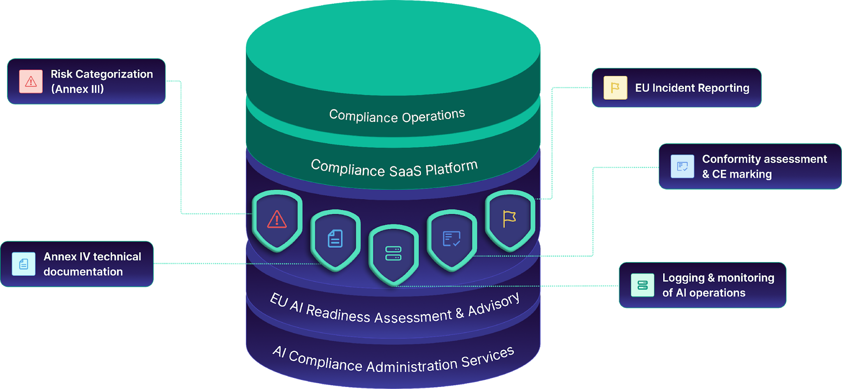
CompliAI Skladnost, poenostavljena
Podpira SHG
https://www.eucompliai.com/contact

Slide 12
CompliAI – Podpira SHG
Predstavitev izdelka
https://www.eucompliai.com/contact
Notes:
First, I’ll walk you through the 7-step diagram to set the context. Then I’ll break down each step in detail, fully aligned with how the flow actually works in the app. And at the end, I’ll play a short product video so you can see the entire process from another angle.

Slide 13


Pot do skladnosti z Zakonom EU o umetni inteligenci: Kako SHG omogoča skladnost z Zakonom EU o umetni inteligenci..
Pot za sisteme z visokim tveganjem: 90 % vseh sistemov umetne inteligence
4
6
Uvedba in vzpostavitev projekta
2
Dokumentacija in pregled skladnosti
Izjava in certifikacija
CompliAI poenostavi dokumentacijo Priloge IV in dokazila o skladnosti za sisteme umetne inteligence z visokim tveganjem.
CompliAI zaključi skladnost z izdelavo osnutka EU izjave o skladnosti in oznake CE, kot ju zahteva Akt o umetni inteligenci.
Centralizirana zbirka podatkov za sledenje projektom umetne inteligence, lastnikom in rezultatom.
Zbiranje dokazil in integracija podatkov
3
1
Ocena skladnosti
5
Revizijsko sledenje in spremljanje v realnem času
7
Ocena tveganja in
poročanje
Povežite modele in repozitorije umetne inteligence; CompliAI zajame metapodatke, poveže dokazila z dokumentacijo Priloge IV in zagotavlja hrambo, pripravljeno za revizijo.
Voden vprašalnik, ki pravno zapletenost prevede v jasna vprašanja. Odgovori neposredno določajo kategorijo tveganja sistema umetne inteligence.
Uporabnike vodi skozi notranje ali zunanje postopke ocenjevanja skladnosti in pripravi poročilo, pripravljeno za revizijo.
Oblikujte kontrole upravljanja, tveganja in skladnosti za zagotavljanje zaupanja in nadzora.
https://www.eucompliai.com/contact
Notes:
This is the 7-step path CompliAI uses to enable compliance of high-risk systems and it’s fully aligned with the EU AI Act, but user-friendly and streamlined:
first you classify risk,
then you create the AI system,
work through the requirements checklist (connect a repository and upload documents),
system auto-compiles the Annex IV draft with a bit of AI touch in the back,
complete conformity assessment (internal or external route),
generate the EU Declaration of Conformity and CE-mark asset,
and finally you stay compliant with our event-based monitoring and audit logging.​

Slide 14
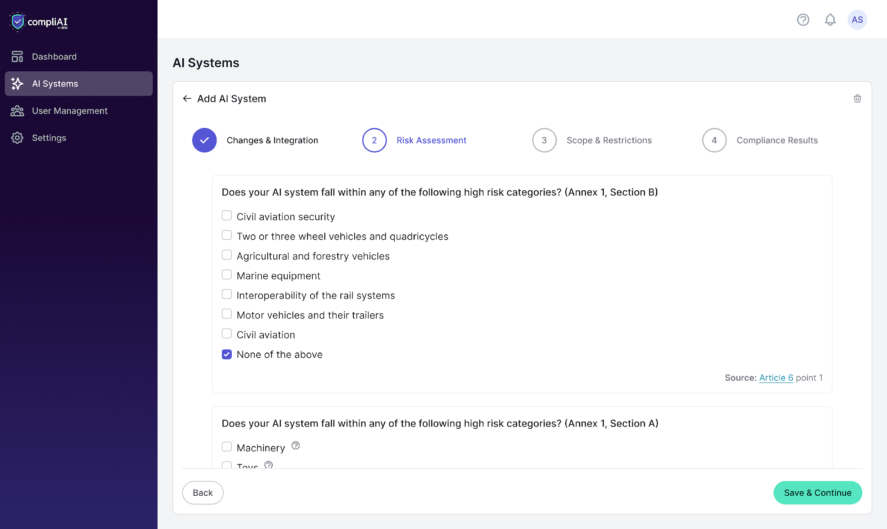
🧭
CompliAI – Ocena tveganja in poročanje
Voden vprašalnik določi: prepovedano / visoko / omejeno / minimalno tveganje
Prepovedano → treba je spremeniti predvideni namen
Visoko tveganje → sproži celoten postopek skladnosti
Samodejno ustvarjeno poročilo z naslednjimi koraki
https://www.eucompliai.com/contact
Notes:
Step 1 — Risk Classification (Questionnaire → Report)
●First comes Risk Classification
●You fill in Short questionnaire → you get your risk category assigned: and it is going to be Prohibited / High-risk / Limited-risk /or Minimal-risk
●If Prohibited: You must change the intended purpose and reassess; because prohibited systems cannot be placed on the market.
●If High-risk: You must complete steps 2–7: so, what follows applies to high-risk AI Systems
●If Limited-risk: You will have Light obligations (e.g., transparency). If you want deeper diligence, you can still follow steps 2–7.
●If Minimal-risk: There is no mandated heavy process; you can adopt good practices (e.g., AI literacy for staff) if you choose.
●You’ll finish with a clean report—risk category plus a step-by-step next-actions summary.

Slide 15
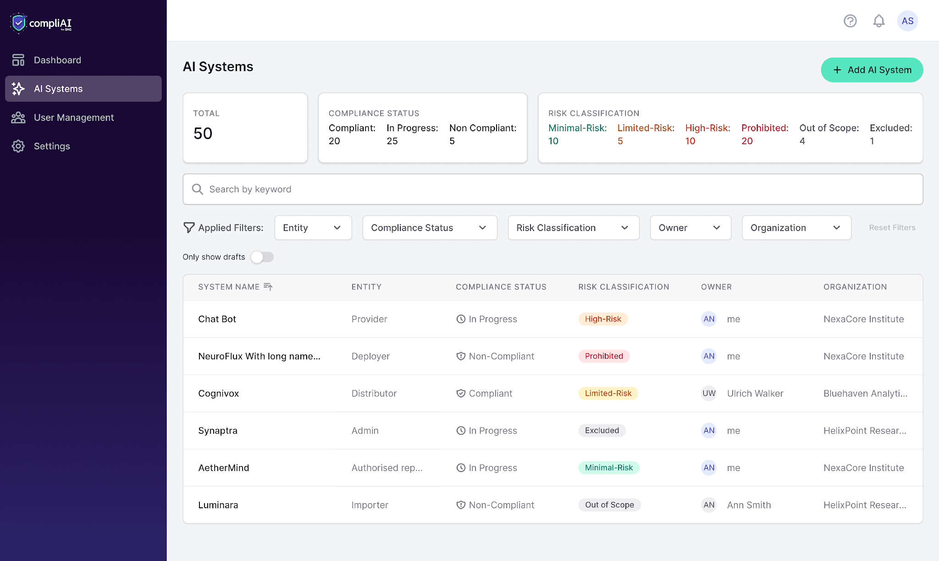
🏗️
CompliAI - Uvedba in vzpostavitev projekta
Potrdite poročilo → ustvarite sistem umetne inteligence
Sistem se doda na nadzorno ploščo s statusom in metapodatki
Označuje začetek strukturiranega življenjskega cikla skladnosti
https://www.eucompliai.com/contact
Notes:
Step 2 — Create Your AI System (from the Report)
●Step 2. If the report matches the facts you provided, select Create AI System. If it doesn’t, revise your answers and re-run the classification.
●By clicking Create AI System the AI system entity will be created in the app and placed on the AI Dashboard with its risk status, and core details.
●So, that is the initial setup of the object we’ll manage through the rest of compliance.

Slide 16
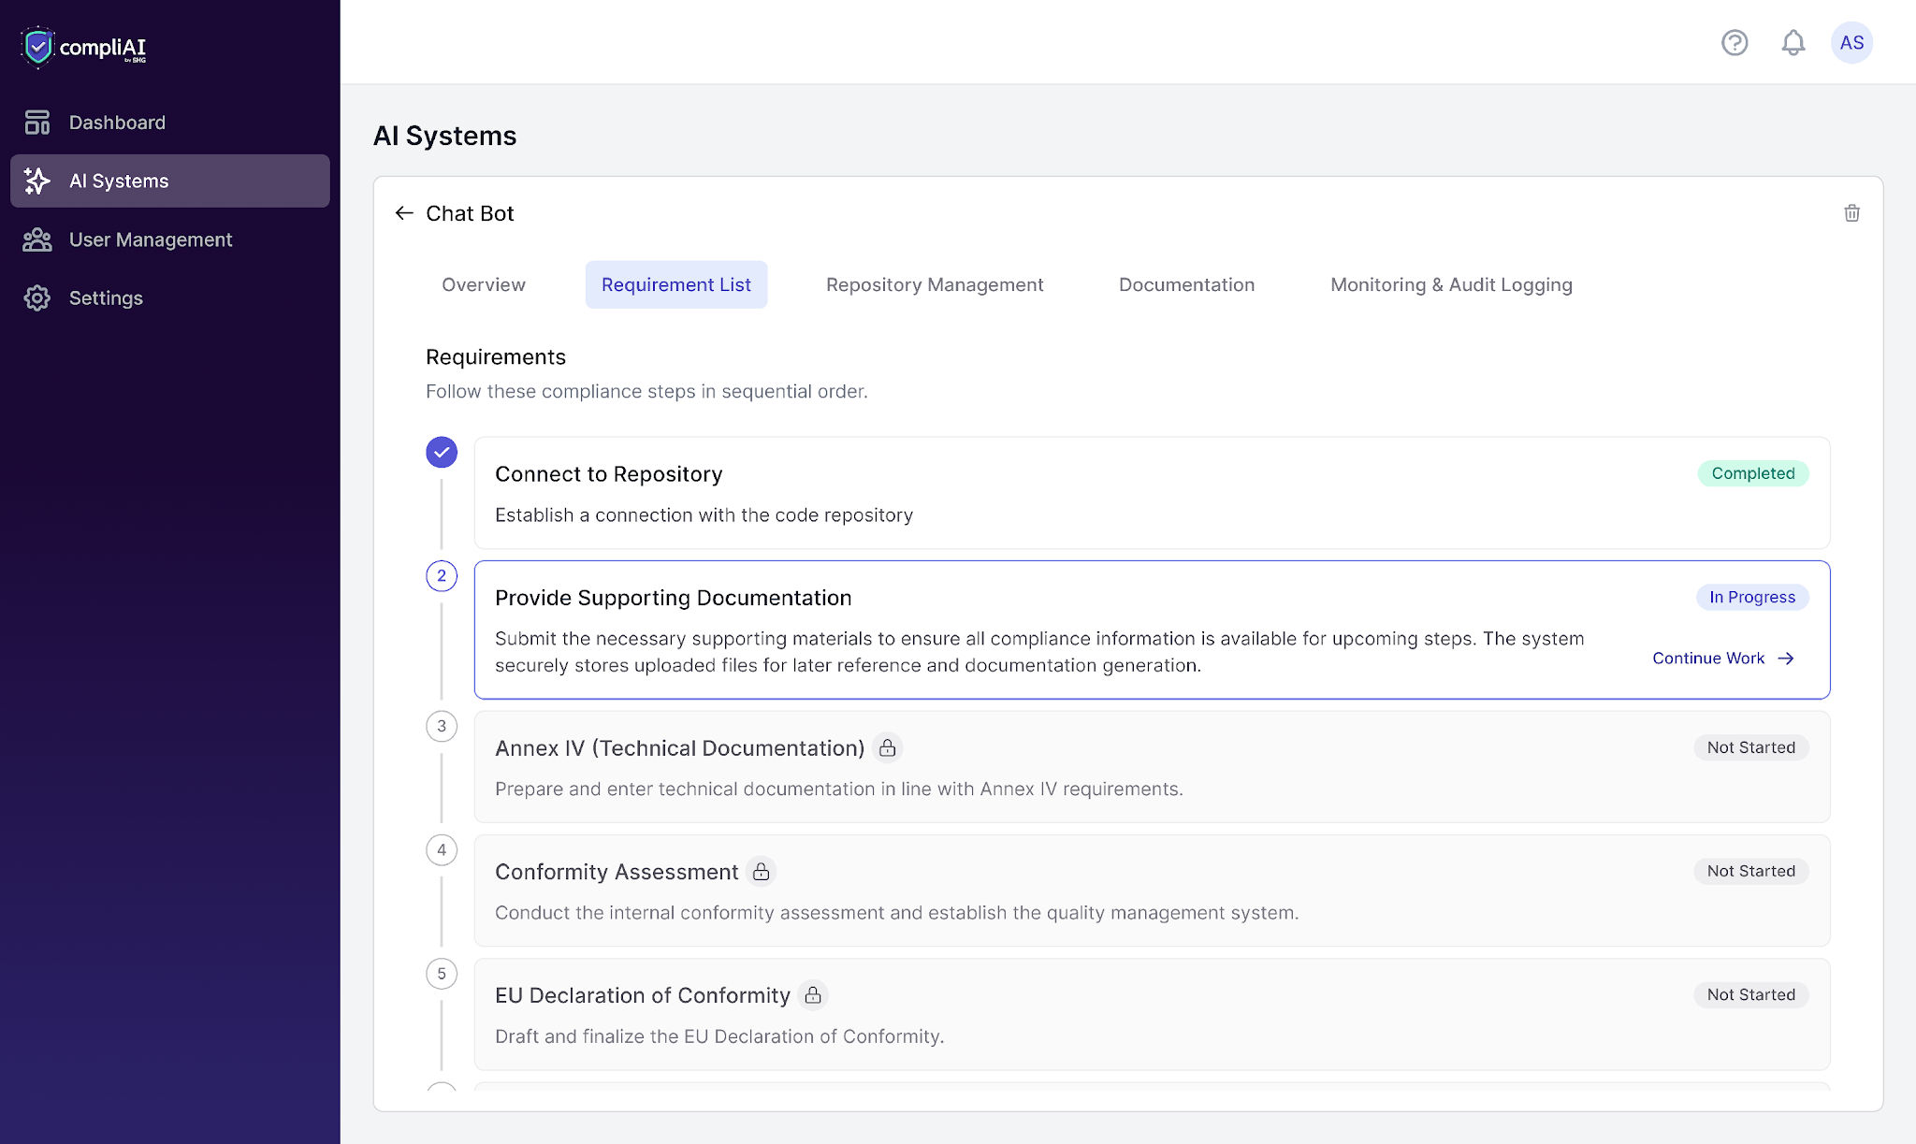
📋
CompliAI - Zbiranje dokazil in integracija podatkov
Centraliziran seznam zahtevanih dokazil
Povežite repozitorij in naložite dokumentacijo
Predstavlja osnovo za Prilogo IV in oceno skladnosti
https://www.eucompliai.com/contact
Notes:
Step 3 — Requirements List (Inputs & Evidence Intake)
●Step 3 is Requirements list. Inside the AI system you’ll see a requirements list - the concrete tasks and evidence we need.
●First, give us access to data and files: repository connection then uploading rest of the documentation
●You’ll get a detailed checklist of what must be provided so we can continue.

Slide 17
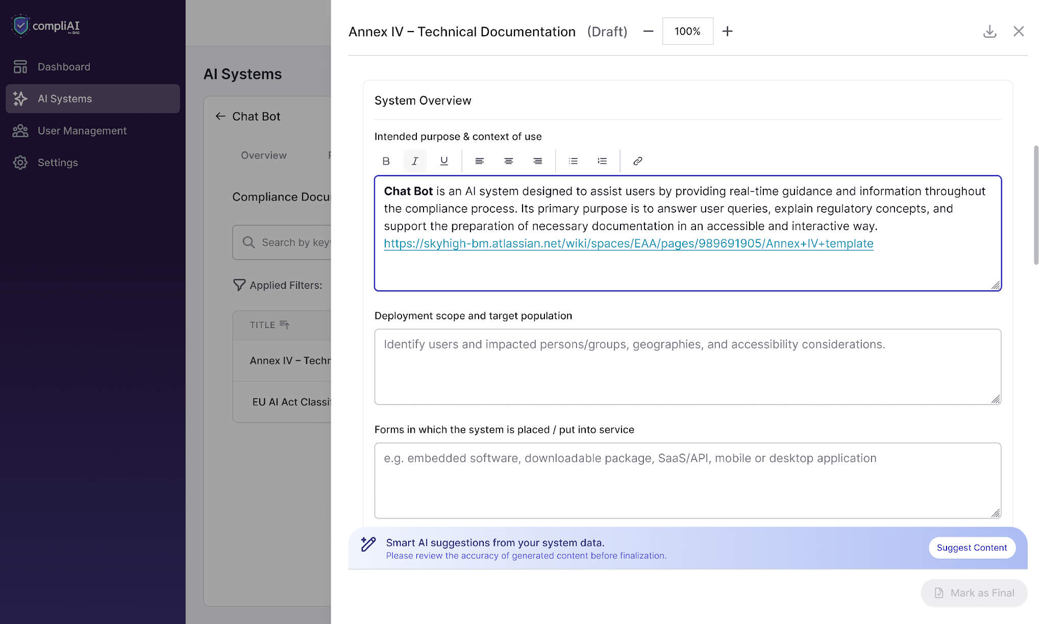
📄
CompliAI - Dokumentacija in pregled skladnosti
Sistem samodejno pripravi osnutek Priloge IV
Poglavja so v celoti usklajena z Zakonom EU o umetni inteligenci
Postane osrednja tehnična dokumentacija
https://www.eucompliai.com/contact
Notes:
Step 4 — Documentation & Compliance Review (Annex IV Draft)
●Next in Step 4, we generate an Annex IV technical documentation draft using predefined sections which are aligned with the Annex IV
●Later outputs (like the DoC) will be linked back into Annex IV.

Slide 18
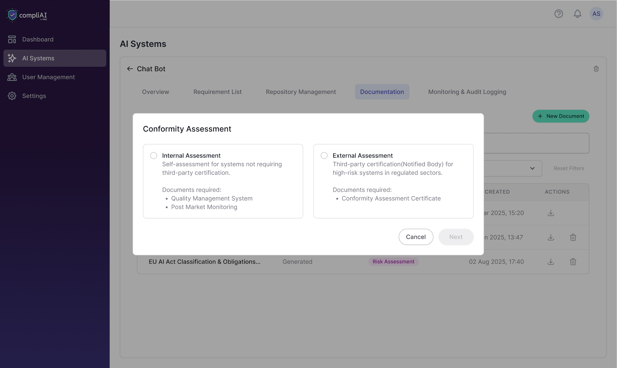
🛡️
CompliAI - Ocena skladnosti
Izberite notranjo ali zunanjo oceno skladnosti
Naložite oceno ali certifikat
Potreben dokaz pred pridobitvijo oznake CE
https://www.eucompliai.com/contact
Notes:
Step 5 — Conformity Assessment (Internal or External)
●In Step 5, depending on your use case you will take the internal conformity assessment route – and verify compliance with legal requirements on your own - or the external route, where a third party performs CA and then you will upload the certificate.
●Either way, evidence of conformity must be provided to proceed.

Slide 19
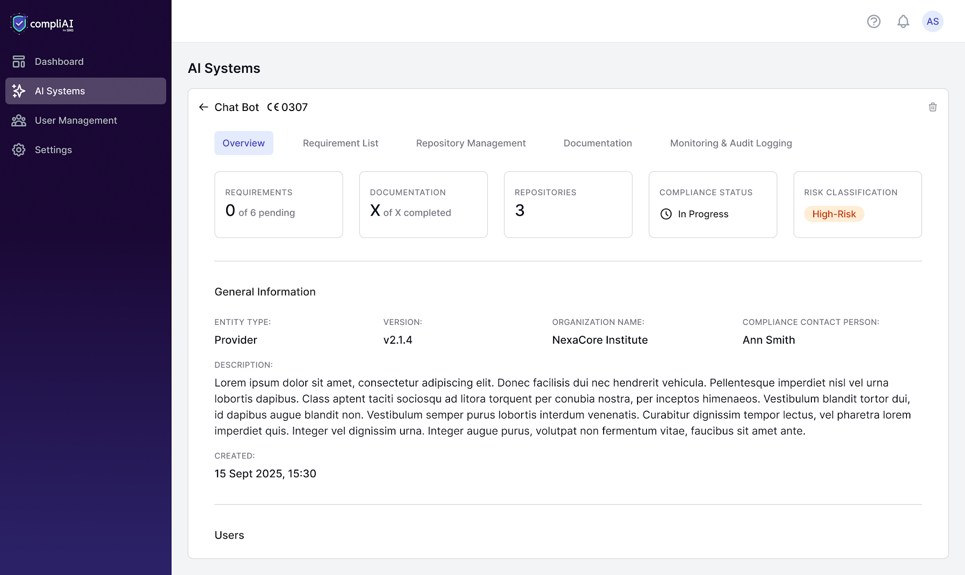
🏅
CompliAI - Izjava in certifikacija
Samodejno ustvarite izjavo o skladnosti iz Priloge IV
Uskladite identifikatorje in datume
Odklenite oznako CE na nadzorni plošči
https://www.eucompliai.com/contact
Notes:
Step 6 — EU Declaration of Conformity → CE Marking
●In step 6, once we have CA evidence, we generate the EU Declaration of Conformity (which is a standard public template).
●We then update Annex IV with the DoC reference (date, identifier, etc.).
●Finally, the system generates a CE marking asset which will be visible in the overview page.

Slide 20
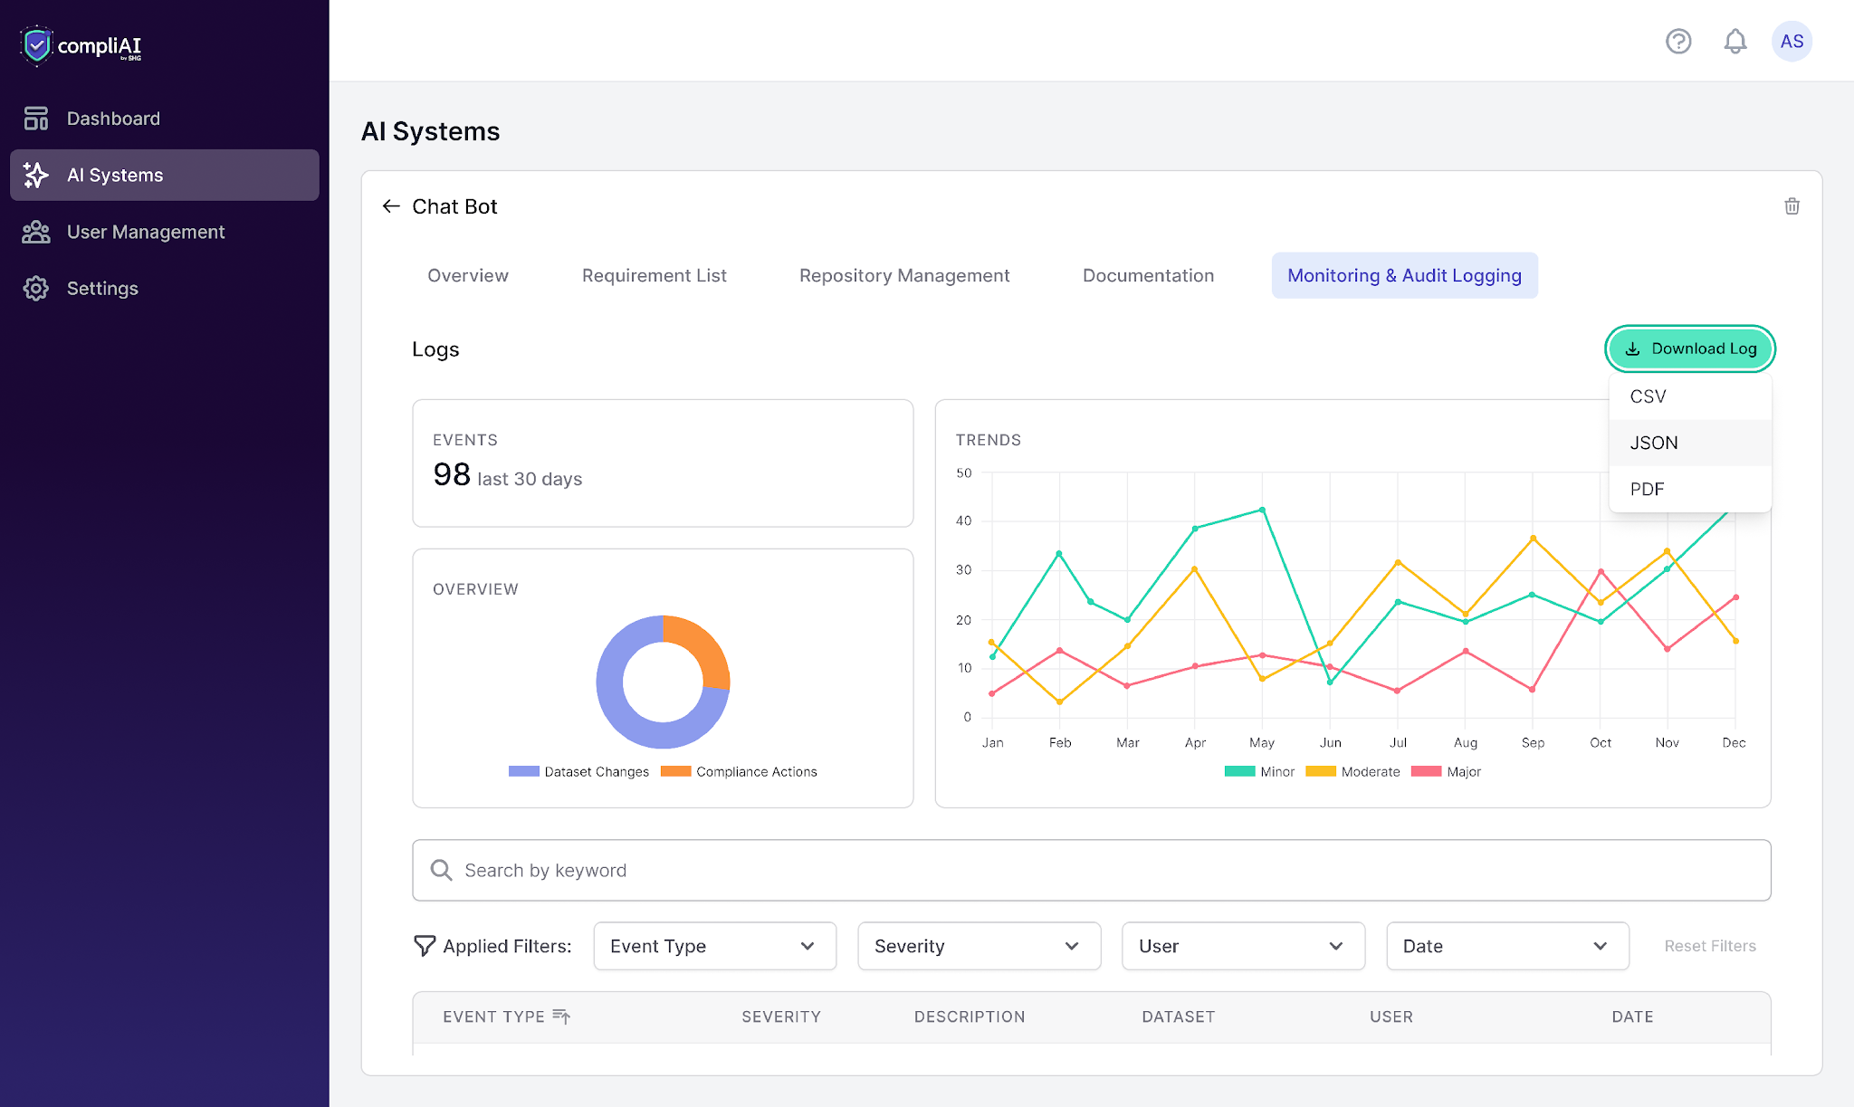
CompliAI - Revizijsko sledenje in spremljanje v realnem času
Spremljanje v realnem času, na podlagi dogodkov
Obvestila o pomembnih dogodkih glede skladnosti
Zagotavlja izpolnjevanje stalnih obveznosti
https://www.eucompliai.com/contact
Notes:
Step 7 — Audit Logging & Real-Time (Event-Based) Monitoring
●Step 7. Monitoring & Audit logging is not a linear step that comes next, it is rather an ongoing event-based activity: where we capture logs and changes as they occur, not on slow batch syncs.
●You’ll see a log table with minor, moderate, and major categories; alerts will fire for major events.
●If we detect a substantial change, we flag it and you may need to go back to re-confirm the assessment.
●You’re obligated to maintain this continuous monitoring and logging.
Now I’ll play you the full product walkthrough — you’ll notice some overlap with what I’ve just explained, but you’ll also see additional details, UI elements, and features that add more context and make the whole flow even clearer.

Slide 21
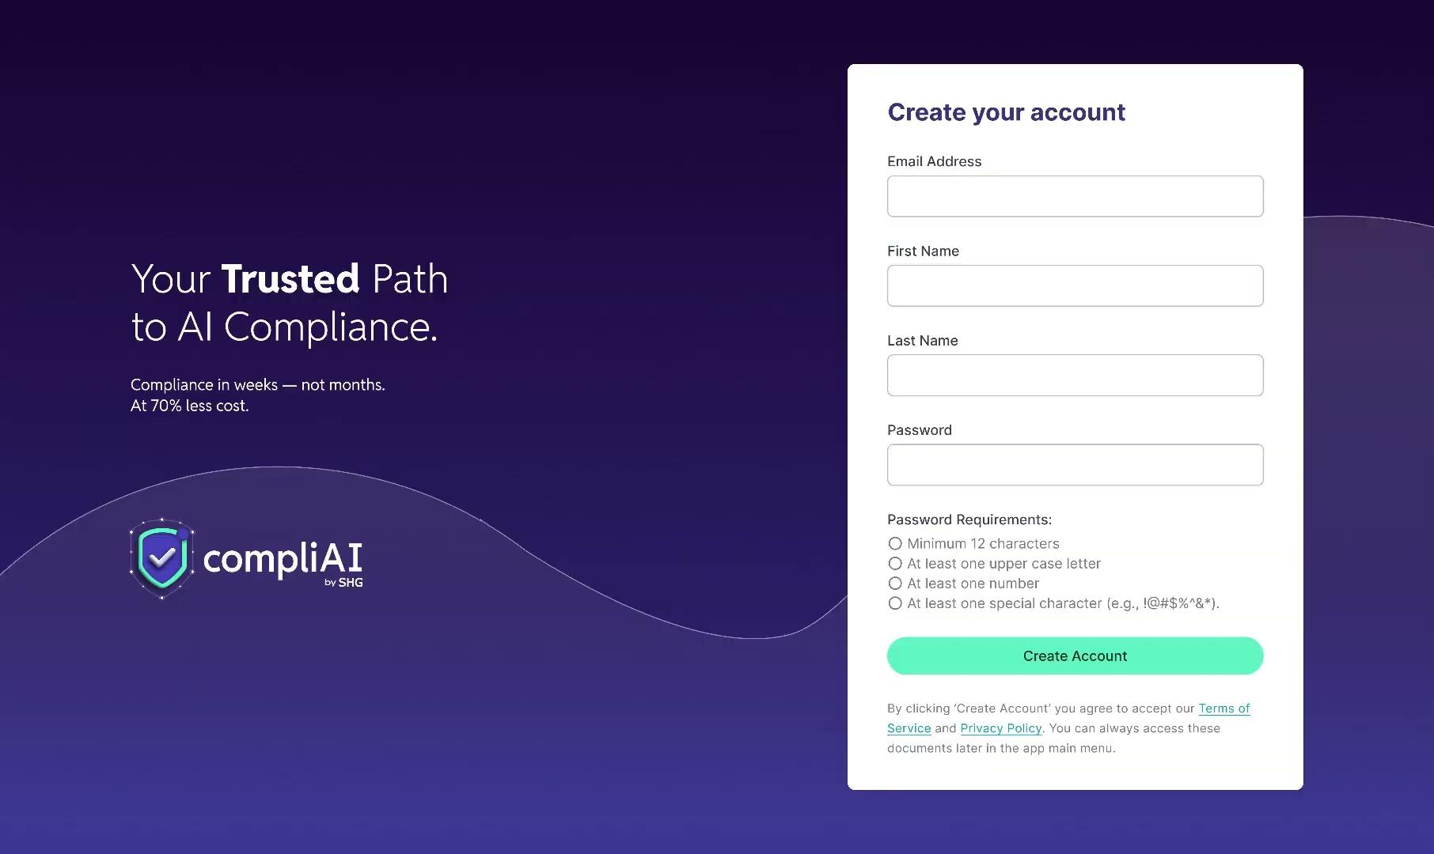
https://www.eucompliai.com/contact

Slide 22
CompliAI– okvir za uspeh strank
Vodena uvedba in pregled tveganj
Zgodnja uresničitev vrednosti in usmerjanje
Usposabljanje in stalna podpora
Stalno partnerstvo
Kaj se zgodi:
Kaj se zgodi:
Kaj se zgodi:
Cilj: Zagotoviti dolgoročni uspeh in merljive rezultate.
Voden ogled za pregled sistemov umetne inteligence in izvedbo prve ocene tveganja neposredno na platformi.
Tedenska srečanja (prvi mesec): pregled rezultatov pregleda, metrik uporabe in reševanje morebitnih ovir.
Dostop do baze znanja CompliAI: vadnice, razlage Zakona EU o umetni inteligenci, vodniki za izvajanje.
Kaj se zgodi:
Konfigurirajte postopke skladnosti in predloge dokumentacije za Zakon EU o umetni inteligenci.
Praktična podpora: izmenjava dobrih praks in svetovanje glede skladnosti.
Podpora znotraj aplikacije 24 ur na dan: neposredna pomoč glede izdelka in skladnosti.
Četrtletni pregledi uspešnosti za oceno sprejetja, regulativnih posodobitev in načrta funkcij.
Določite merila uspeha: sprejetje, pokritost sistemov in kakovost dokumentacije
Pregled nadzorne plošče: zagotovite, da stranke izkoristijo vpoglede in točkovanje tveganj CompliAI.
Izbirno strokovno svetovanje: dodatne delavnice o oceni skladnosti, pripravi na revizijo ali zasnovi upravljanja.
Povratne zanke, ki neposredno vplivajo na razvoj izdelka.
Letni poslovni pregled z vodstvom
https://www.eucompliai.com/contact
Notes:
What happened
iBorderCtrl was a project funded by the European Commission and deployed in trials at border crossings in Greece, Hungary and Latvia
The system used facial-movement tracking and other biometric cues (for example micro-expressions) purportedly to assess whether a person was lying when answering questions at the border. WIRED+1
Soon after deployment, serious concerns were raised: the company itself admitted the technology “may imply risks for fundamental human rights.” WIRED
Ultimately the project was dissolved. The technology proved unreliable, and critics flagged it as an inappropriate use of AI for high-stakes decisions. WIRED+1
Why it went wrong
High-stakes context: Deploying an AI system that assesses truthfulness/arousal at border control implicates freedom of movement, human rights, discrimination risk, and power imbalance.
Unreliable methodology: Lie detection via micro-expressions or biometric cues is widely disputed in the scientific community. Using it without robust validation is risky.
Transparency & oversight issues: Individuals subject to the system likely had limited ability to challenge or understand decisions.
Regulatory & ethical gaps: This use case clearly triggers what the forthcoming EU AI Act would consider a “high-risk” or even “unacceptable risk” system (remote biometric identification, profiling). The trial illustrates the need for governance from the regulatory side.
Lessons and relevance under the EU AI Act
This case underscores why the EU’s risk-based categorisation (unacceptable risk / high risk) is necessary: Some uses of AI simply should not be deployed without stringent safeguards or may be prohibited.
It shows that companies deploying AI in sensitive areas (border control, biometric identification, movement of persons) must maintain rigorous evidence, transparency, human oversight and robust documentation.
For compliance, one must recognise that:
Prior to deployment of certain AI systems, fundamental rights impact assessments are needed.
Transparency (i.e., explaining what the system does and how) and human oversight (a human in the loop) are critical.
Data governance, accuracy, robustness, fairness and security should be embedded from the design phase.
It also signals that weak governance or experimental deployments in absence of full oversight can damage reputation, lead to public backlash, and increase regulatory scrutiny.

Slide 23
CompliAI– pot vrednosti za stranke
Potencialna stranka
Potreba po rešitvi za upravljanje umetne inteligence
Ozaveščenost
Ocenjevanje
Zaveza
Uvajanje
Izvajanje
Prepoznavanje in primerjava platform za upravljanje umetne inteligence
Ponudba storitev
Preizkus orodja CompliAI
Preizkusno okolje in preizkusna doba
Komercialni pogoji
Naročilnica
Trajanje zaveze
Dodelitev vodje za odnose s strankami (CSM)
Pozdravljeni pri CompliAI
Usposabljanje administratorja
Vzpostavitev programa upravljanja sprememb
Inventar sistemov umetne inteligence
Konfiguracija platforme
Izmenjava dobrih praks
Anketa o zadovoljstvu strank (CSAT)
Pregled – četrtletno
Model zrelosti
Vrednost funkcij
Načrt skladnosti
Usposabljanje in podpora
Pregled sprejetja, kakovosti dokumentacije in regulativnih posodobitev
Ocena modela zrelosti upravljanja umetne inteligence
Skupni razvoj dolgoročnega načrta za izboljšanje skladnosti
Ocena obvladovanja platforme
Podpora za uspeh skladnosti — Art of Possible
Skupna priprava 12-mesečnega načrta skladnosti
CompliAI University
2- do 5-dnevni program usposabljanja za uporabnike
Stalna podpora znotraj aplikacije
Zagovornik
Stabilnost sistema
Povratne informacije o izdelku
Priložnost za širitev
SOS > Tveganje
Program zagovorništva
Ambasador CompliAI
Nadzor vodje za odnose s strankami (CSM) nad platformo in delovnimi postopki
Sodelovanje s tehničnim vodjem za stranke (TAM) in preverjanje stanja sistema
Poslovni pregled z vodstvom
Vpogledi se neposredno vključijo v načrt razvoja funkcij CompliAI
Prepoznavanje dodatnih poslovnih enot, sistemov umetne inteligence ali regij za širitev
Ocena tveganja s tehničnim vodjem za stranke (TAM)
Povabilo v program zagovorništva CompliAI
Povabilo na posebne dogodke za stranke
23
https://www.eucompliai.com/contact

Slide 24




FAQ
Kontaktirajte nas preko Odvetniške pisarne Toš in partnerji d.o.o.
Sales SHG
sales@skyhighgrowth.com
https://www.skyhighgrowth.com/
https://www.eucompliai.com/contact

